Slide 1
Animalopoly - Documentation

Slide 2
Disclaimer
This PowerPoint outlines how your coursework will be marked not how you should lay it out.
The actual structure for your coursework is more likely to follow the structure below:
Analysis
Pre-Development Design/Planning
Development
  Iterative Planning
  Development
  Iterative Testing
Post-Development Testing
Evaluation
Repeat until development complete

Slide 3
Analysis

Slide 4
Analysis
The purpose of the analysis section is arguably the most important section because it forms the basis of the plan you will build your project from.
You’ll figure out your user requirements and use these to produce the success criteria that you will ultimately use to evaluate your project.
You’ll also conduct research and define your “products” place in the world, you’ll end up answering questions like:
  Is it something that is needed?
  Is it something that is wanted?
  How is it better than the existing alternatives?

Slide 5
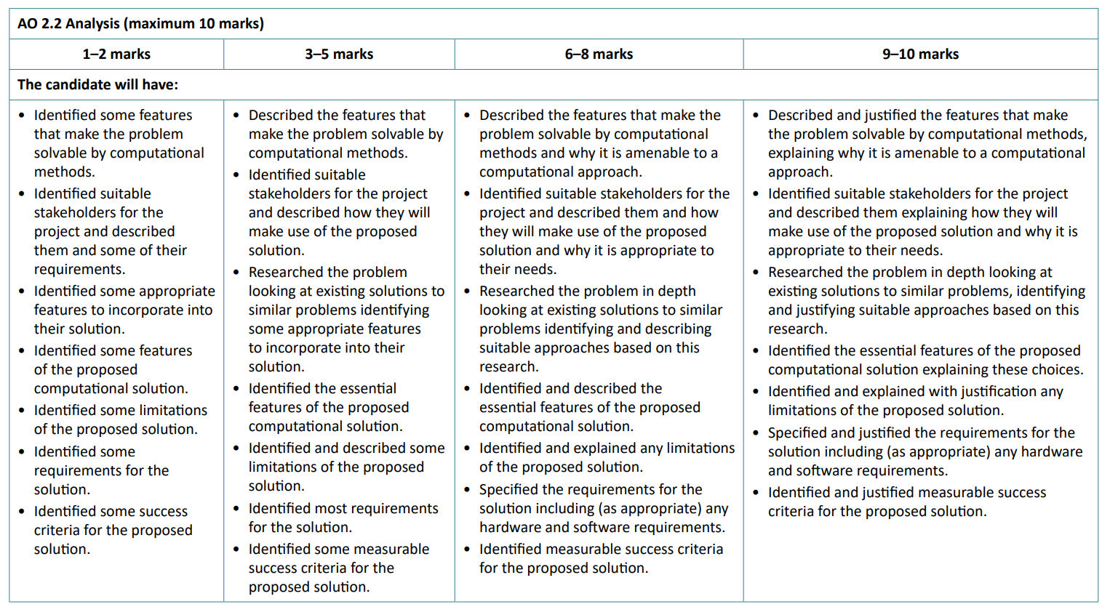
Analysis – How is it marked?

Slide 6
Analysis – How is it marked? (Simplified)
Your attempt to research the problem and define the requirements and success criteria is limited.
e.g.
You’ve identified teenage girls as your intended user group, but you’ve only identified some of their requirements.
Your attempt to research the problem and define the requirements and success criteria is better but you’ve still missed some opportunities.
e.g.
You’ve identified teenage girls as your intended user group, but you’ve only identified most of their requirements.
Your attempt to research the problem and define the requirements and success criteria is good and you’ve explained your decisions well.
e.g.
You’ve identified teenage girls as your intended user group, identified all their requirements, and explained how your project will meet these requirements.
Your attempt to research the problem and define the requirements and success criteria is good and you’ve justified your decisions by saying what other decisions you considered and why you made the decision you di.
e.g.
You’ve identified teenage girls as your intended user group, you’ve identified all their requirements, and justified how the decisions you’ve made will meet.

Slide 7
Analysis – How is it marked? (Simplified)
SOME
MOST
EXPLAINED
JUSTIFIED

Slide 8
What does justify mean?

Slide 9
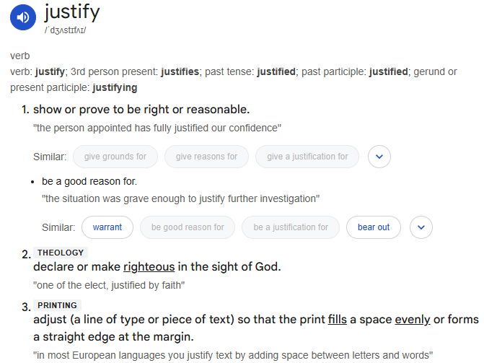

Slide 10
The key idea with justifying is that you need to be able to explain why you made the decisions that you made.
If you only focus on what you decided, then you won’t be able to access the top mark band.
For some decisions, where there are limited alternatives, this will be easy:
  “I chose to use an array for players’ scores as this allowed me to store multiple pieces of data in a mutable structure that had a single, indexable, identifier.”
For others, where the were more potential options it is good practice to show that you’ve considered those other options and explain why you chose the option you did.

Slide 11
Justification Example – Turn Based RPG Stakeholders
I have decided that my target audience for my turn-based RPG will be thirty- to forty-year-olds as the game I am making is inspired by the Final Fantasy games that were released in the mid to late 90s. While they are likely to have less spare time than the other target audiences I considered they are also more likely to have disposable income as they are further into their careers than a younger target audience.
I also considered twenty- to thirty-year olds and teenagers as a target audience but while these games have had an enduring popularity, and it is likely that younger people will be familiar with them, I am hoping that a slightly older target audience may have a nostalgia for this style of game and story telling.
The other possibility would have been an older target audience, who are even more likely to have a disposable income, but they are less likely to play video games, so they were discounted as a possibility early in the process.

Slide 12
Justification Example Justified – Turn Based RPG Stakeholders
I have decided that my target audience for my turn-based RPG will be thirty- to forty-year-olds as the game I am making is inspired by the Final Fantasy games that were released in the mid to late 90s. While they are likely to have less spare time than the other target audiences I considered they are also more likely to have disposable income as they are further into their careers than a younger target audience.
I also considered twenty- to thirty-year olds and teenagers as a target audience but while these games have had an enduring popularity, and it is likely that younger people will be familiar with them, I am hoping that a slightly older target audience may have a nostalgia for this style of game and story telling.
The other possibility would have been an older target audience, who are even more likely to have a disposable income, but they are less likely to play video games, so they were discounted as a possibility early in the process.

Slide 13
Animalopoly - Analysis
Because the analysis section of your project is so big and important doing it properly for Animalopoly would mean there is no time for the other stages.
Instead, you will be given the success criteria and will need to design, develop, and evaluate against these.

Slide 14
Design

Slide 15
Design
There are two types of design that you need to show:
  Pre-development design and planning
  Iterative design and planning.

Slide 16
Pre-development design and planning
Before you start development, you need to show that you:
planned your GUI design (including accessibility considerations)
created a structure diagram
created a development plan (including a post-dev test plan)
As with the analysis stage, you need to make sure that you are just justifying your designs:
Why did you put you character health in the bottom right?
Why have you planned to develop the characters before the level?
Why have you used inheritance to make different types of enemy?

Slide 17
Iterative design and planning.
Before you develop each module/class/sub-routine you need to show evidence that you’ve designed and planned the stage.
The exact evidence you include will depend on your project and the approach that you use but this should include:
algorithms – pseudocode/flowcharts
data-dictionaries – key variables, validation, constants etc.
data structures – which arrays/structures are you using?
diagrams – class diagrams, site-maps, entity relationships

Slide 18
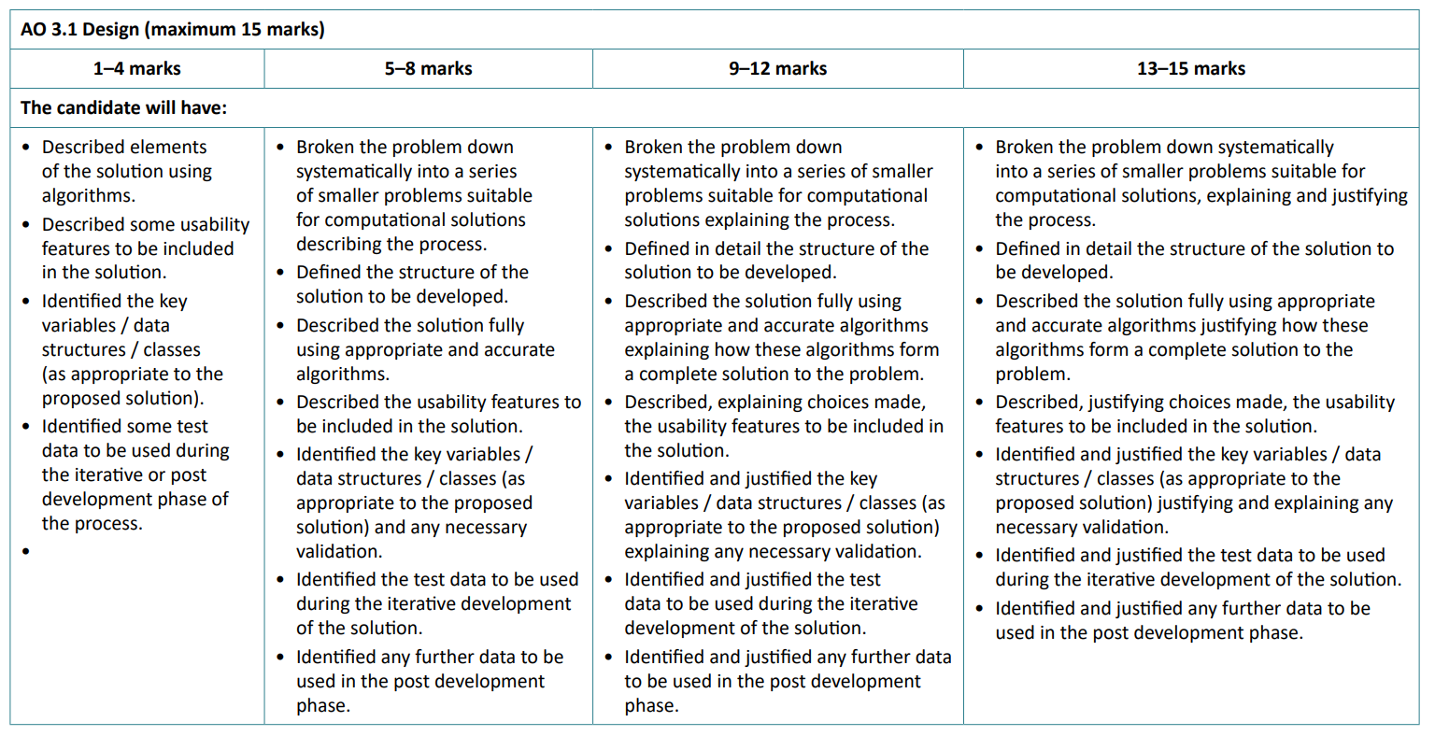
Design

Slide 19
Design
SOME
MOST
EXPLAINED
JUSTIFIED

Slide 20
Development

Slide 21
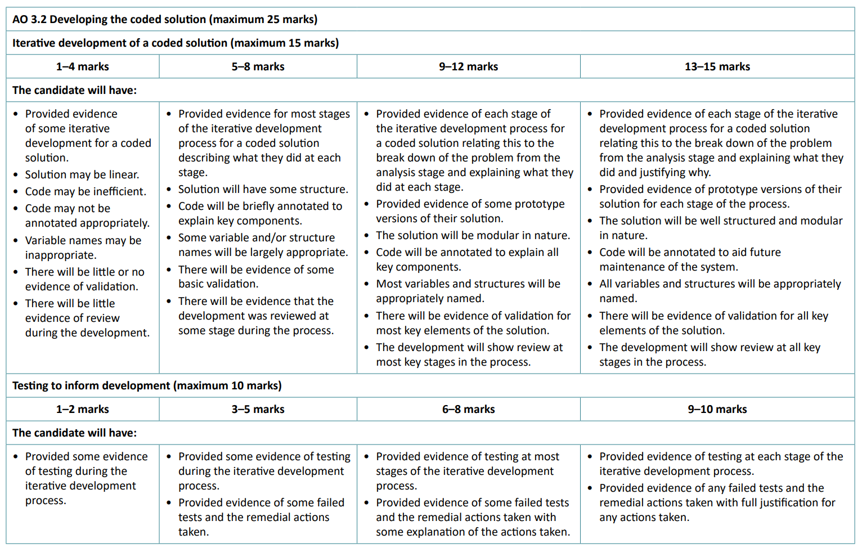
Development
Development should be shown as an iterative process – you should plan, code, test, repeat until the success criteria have been met.
You are aiming for the following:

Slide 22
Development
You should have decided the order of your development in your plan and where possible you should stick to it (it’s fine if things don’t as long as you justify why you made the change).
There should not be large gaps in your development – if you are developing a class then you should run and screenshot your code after you have coded each method (it’s ok to do one screenshot for all the getters/setters at once) and:
explain what you’ve done and why you did it – for example, why didn’t you make a getter/setter for a particular attribute?
do the planned test to make sure the method works as expected
show the outcome of the test
You also need to show that you’ve reviewed your development throughout – are you meeting the deadlines you set, what areas are taking longer than expect and why?

Slide 23
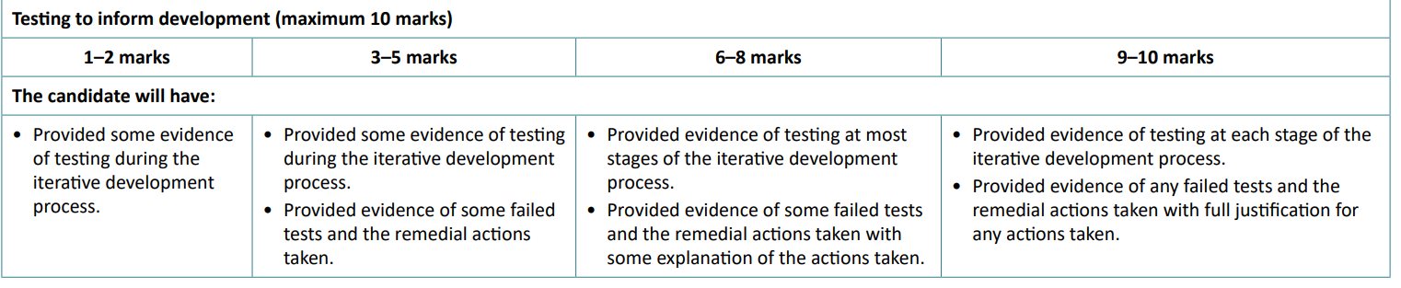
Development – Iterative Testing
You need to show your failures!
There are eight marks (out of 75) available for providing evidence that your code didn’t work at first and that you had to make some changes. The better you can explain what remedial action you took (and why you took that action) the more marks you will get.

Slide 24
Development

Slide 25
Development
SOME
MOST
EXPLAINED
JUSTIFIED

Slide 26
Evaluation
It’s ok not to meet all your success criteria – you just need to be clear about whether they have been fully, partially, or not met.
For any that you are saying have been fully or partially met then you will need evidence to prove this, and you’ll need to explain how the evidence shows that the criteria has been met – wherever possible this should be a screen recording that you reference in your testing table.
For any partially met or unmet criteria you need explain how they could be met through further development – this is a good opportunity to reflect on why you weren’t able to meet them.

Slide 27
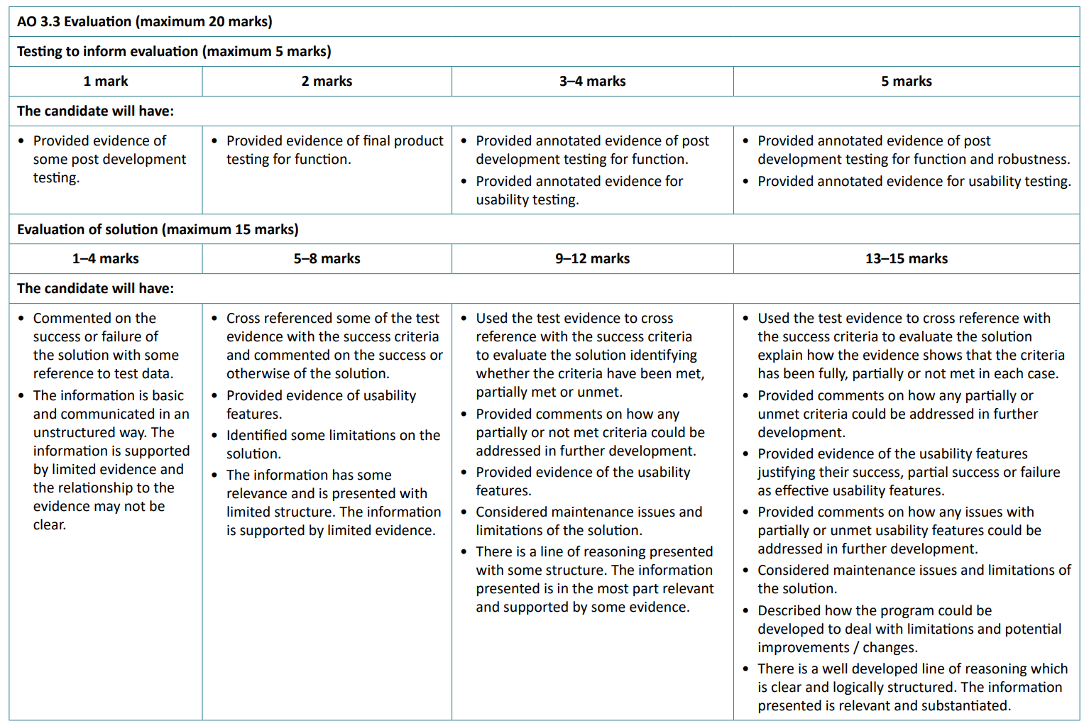
Evaluation

Slide 28
Evaluation
SOME
MOST
EXPLAINED
JUSTIFIED

